Slide 1
Game Design & Production
Advanced Diploma of Professional Game Development
Certificate III Media in Game Design
GAME CAMP !
Notes:
Welcome!
This evening we are going to talk a little about the Game Design & Production course.
We’ll give an idea of what the aim of the course is
We’ll describe a what a game designer does, their skills and what they might be asked to do
And then we will give an overview of the course itself, finishing up with what you can expect to do once completed.
If you have any questions along the way, please don’t hesitate to ask.

Slide 2


Overview
The Game Design & Production course of the Advanced Diploma of Professional Game Development is designed to help graduates attain the skills required to be industry effective game designers.
Learn game design from teachers with real industry experience
Practical focus – Make games
to become industry-ready
Notes:
The Game Design & Production Advanced Diploma is geared towards making graduates industry ready.
We are here because of our industry knowledge and we are shaping/creating the course now.
LA Noire
MAD MAX
GETAWAY SERIES
Nominated for 3 BAFTAs

Slide 3
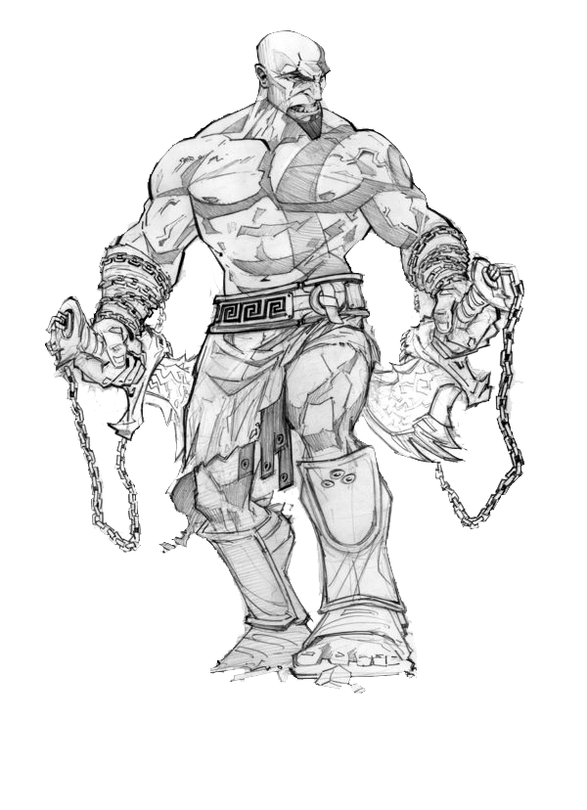
So who are game designers?

Slide 4

The role of the designer
The defender of the player experience, those responsible for the fun
Not just an ideas person – A designer ensures the ideas are both suited to the game, and well executed
Evangelist of the game, and the systems in it
Notes:
Talk about how important it is to keep your team focused on the end goal.
You may well need to talk to Press.
You are the champion of the game experience!

Slide 5
Tasks for designers include…
Generate and facilitate game ideas and concepts
Validate concepts through prototyping and play testing
Write and maintain design documents
Create, edit or tune content
Script gameplay events in ‘levels’
Notes:
Relate this to what we have done in the past.

Slide 6
What lies in store…
Year 1 of Game
Design & Production

Slide 7
Fundamentals
Learning the terminology and role of the game designer
Game design theory
The basics of art content creation
Working with production teams
Prototyping your own creations
Notes:
Walking into a company without these skills is a disadvantage, being prepared puts you ahead of the competition.

Slide 8
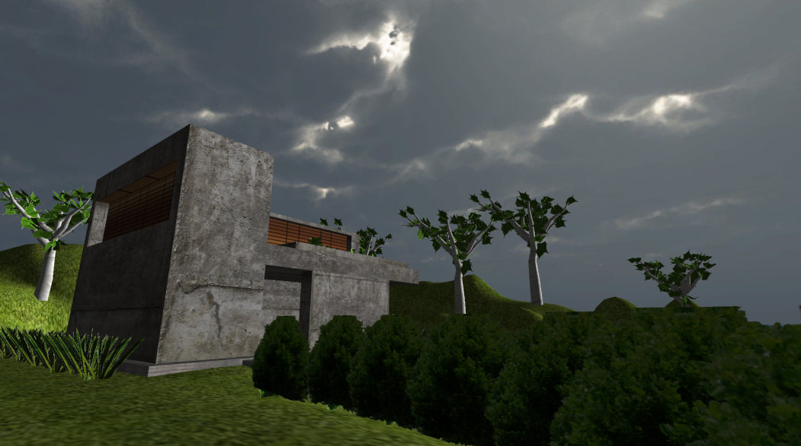
More Fun-damentals
Designing game levels and user interfaces
Pen & paper prototyping
Crafting gameplay experiences
Coding with Unity scripts
Notes:
Practical experience is invaluable.

Slide 9
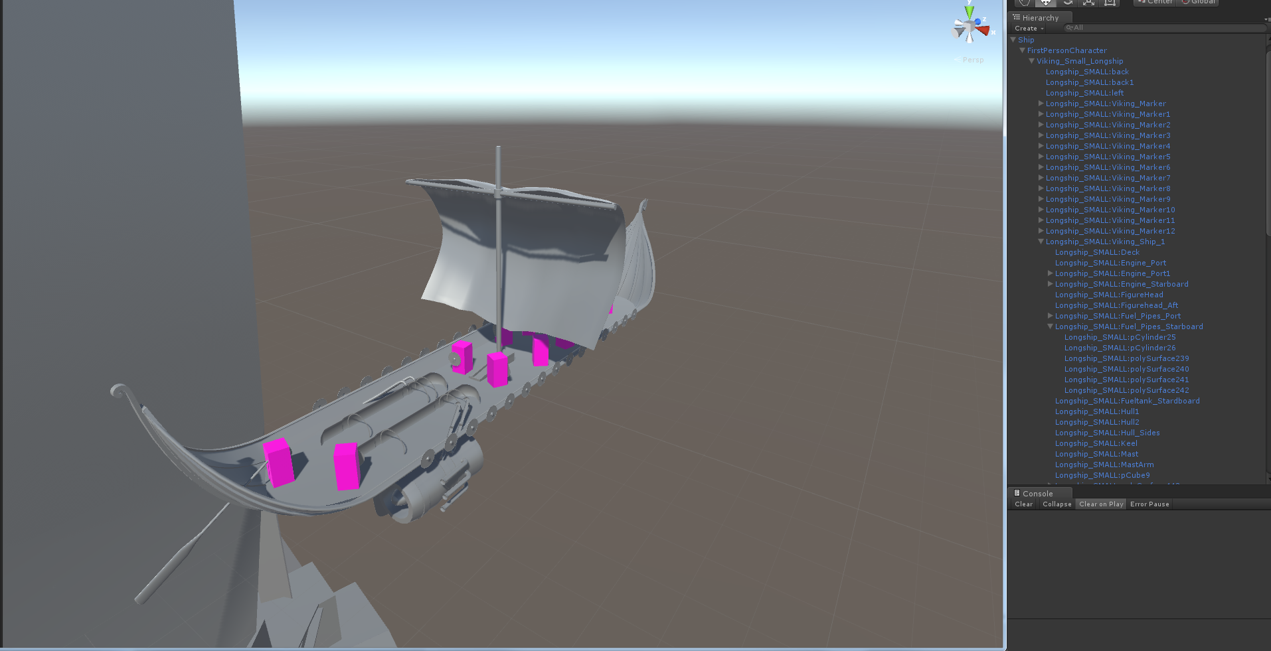

Game designers code??? What’s Unity?
Unity is a game engine software commonly used in the games industry
Notes:
Budding level designers should familiarise themselves with Unity.

Slide 10
What lies in store…
Year 2 of Game
Design & Production

Slide 11

Design & Production
The psychology of games – Explore thinking and decision making processes
Understanding the producer’s role
More prototyping, with a variety of game genres and platforms
Notes:
By this point students will know how to walk the walk and talk the talk!

Slide 12
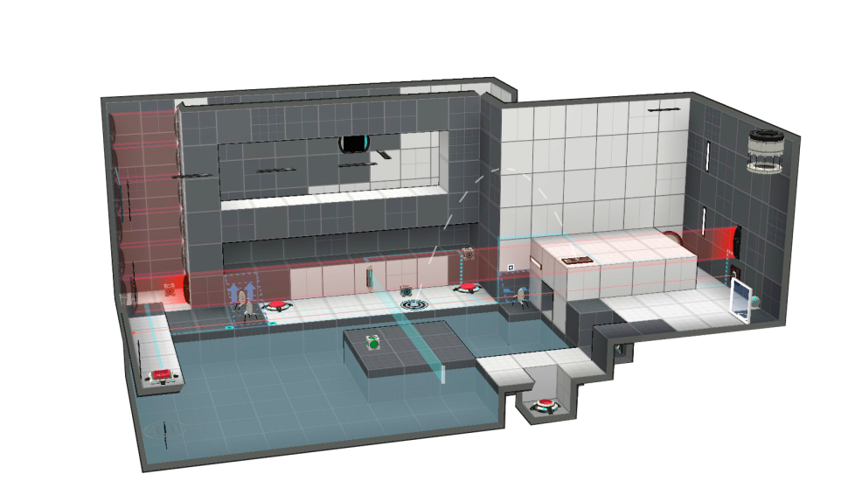
2nd Year Game Project
Collaborate with game art and programming students for a game project
Develop a portfolio and skill at working with a multi-disciplined team
Present to an industry panel for both feedback and exposure
Notes:
Having a product to show a potential employer or investor is critical.
Understanding the development process and finishing a project are some of the toughest, but most important skills to learn. We aim to guide the students to get this experience so they are well prepared to work in the industry.

Slide 13
Beyond the course…
Graduate career options

Slide 14
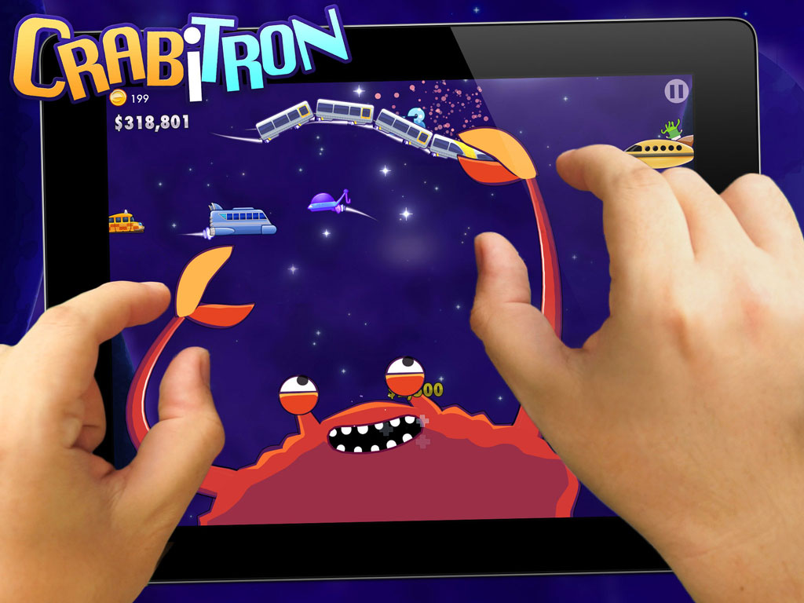
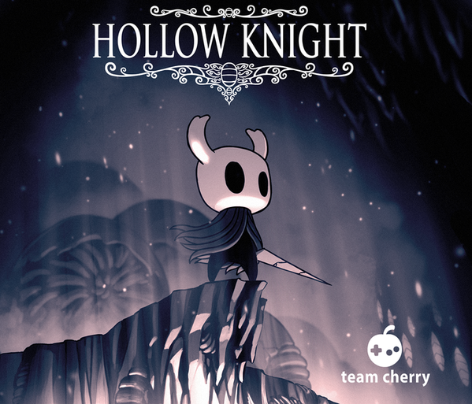

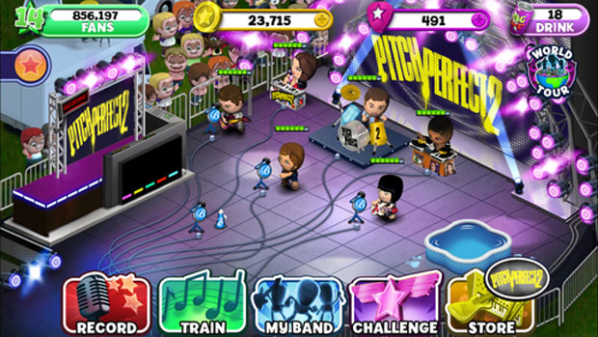
Industry employment
Major games studios, both in Australia, and overseas
Independent Studios
Relevant skills to perform contract work
Notes:
Adelaide studios are making great games!

Slide 15
Indie development – The Incubator
AIE Incubator program (a 3rd year study option) provides the ideal environment to enter the industry as an indie developer. Provides office space, professional mentoring and scholarship funds while you learn:
Starting a business
Marketing, community development
Production and management planning
Contracting and funding applications
Notes:
Great option if you want to learn how to start your own Indie Studio.

Slide 16
How do I start?
Prepare a portfolio of your game designs, game reviews, game mods, game levels, etc.
Try using Unity, Unreal or Gamemaker.
Show us you are passionate about making games, not just playing them.

Slide 17
Game Design Foundations and Game Camp
Do AIE’s Certificate III Media course in Game Design Foundations
10 weeks
2-3 nights a week + a Saturday
30 SACE pts
12-15-years-old? Come to GAME CAMP where we introduce you to Unity and creating gameplay!

Slide 18
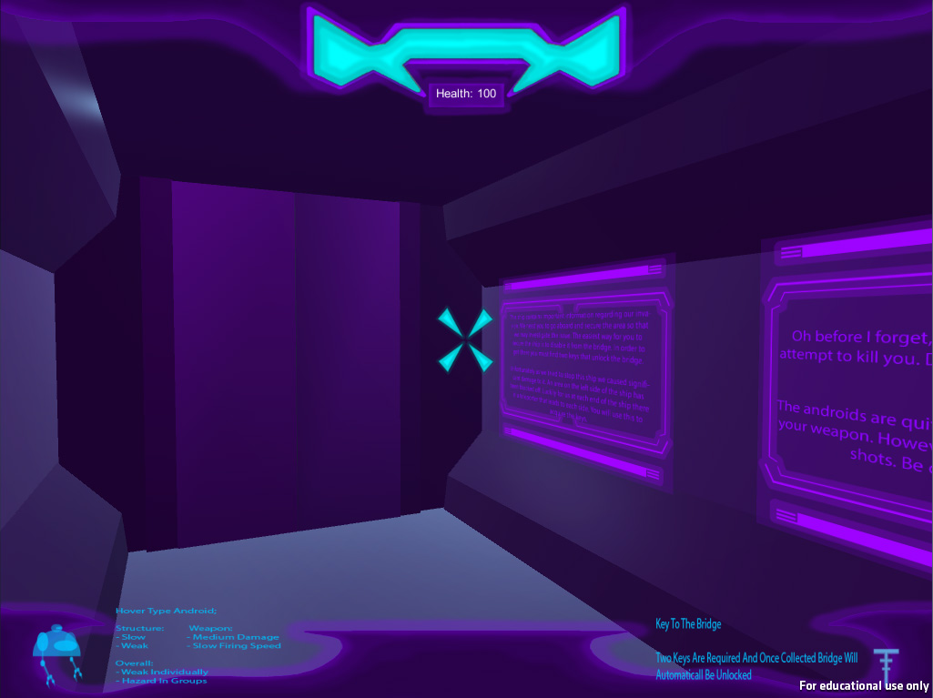
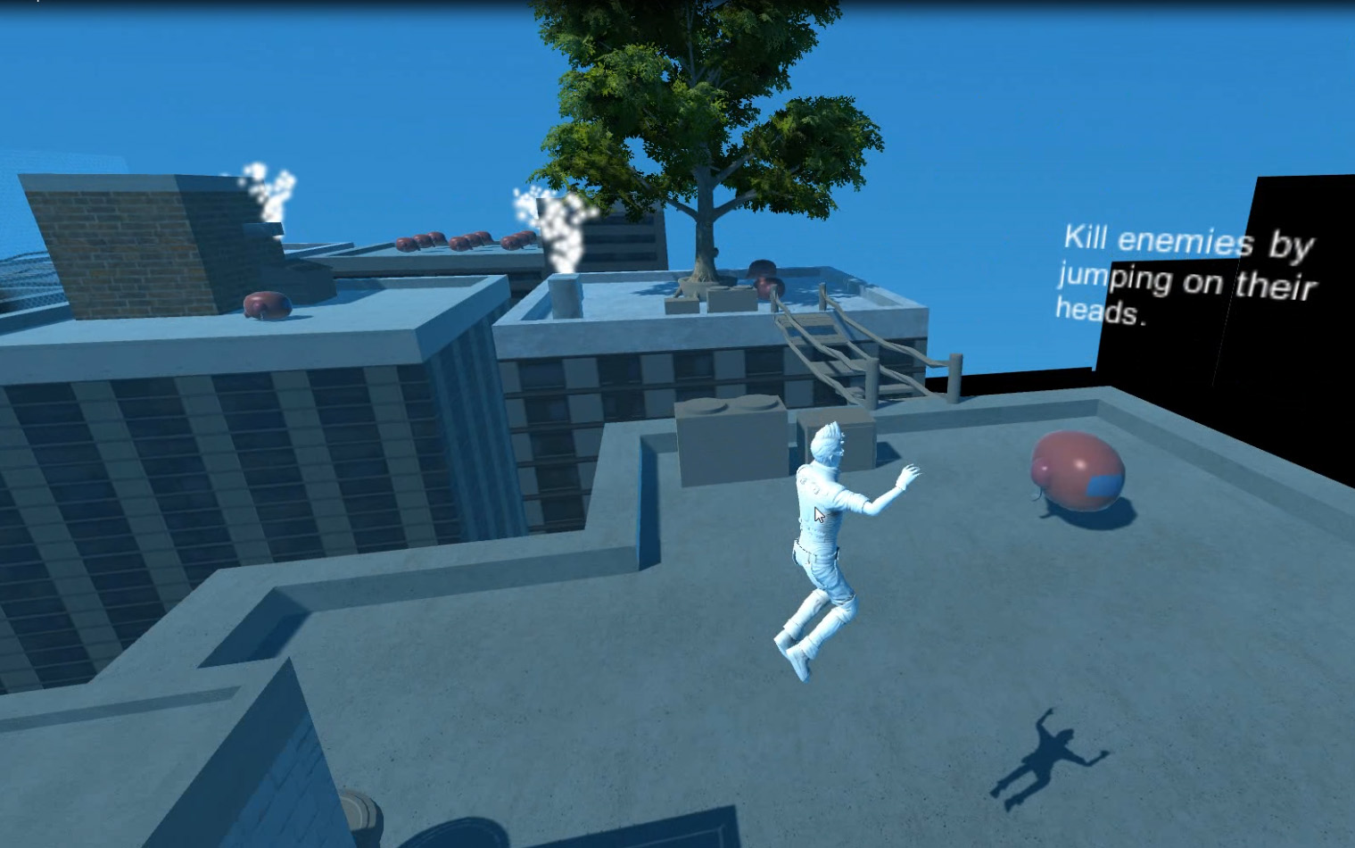
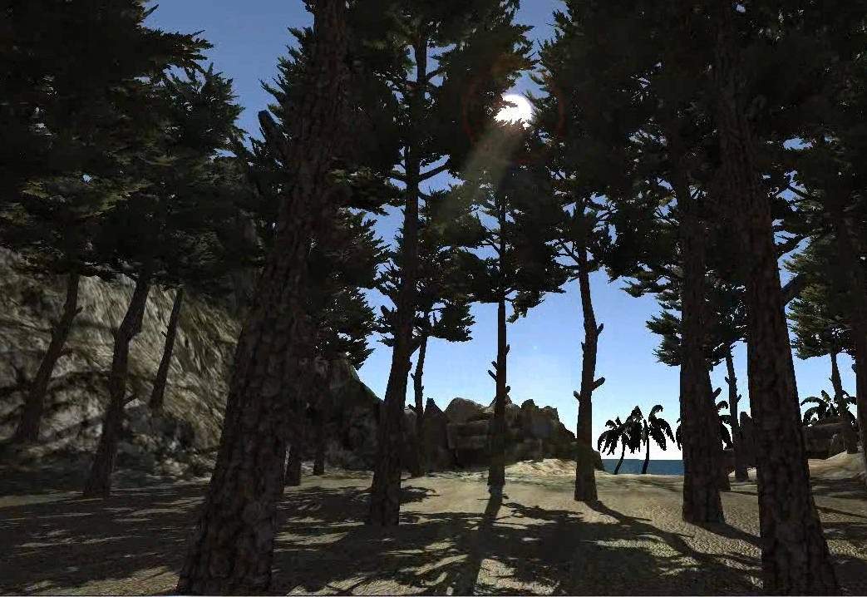
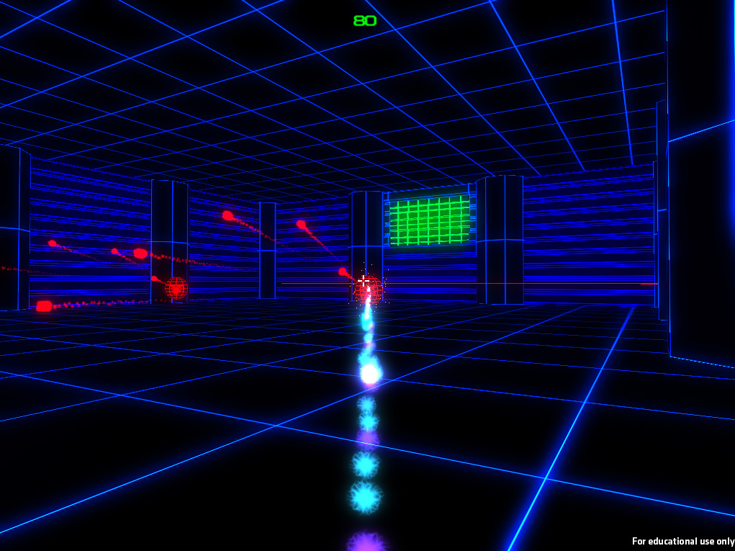
Game Design Foundations

Slide 19
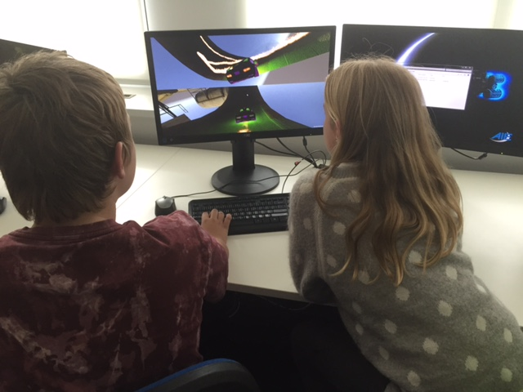
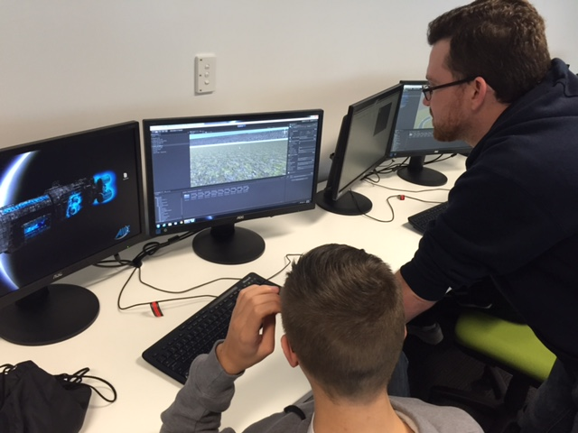
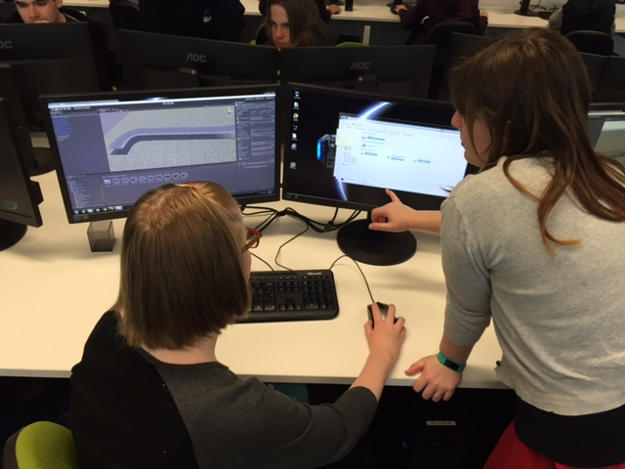
GAME CAMP

Slide 20

Thanks for your time. Questions?

